Slide 1
Alcohol Sales vs. Poverty Rate in Iowa
By:
John Ro, Eddie Stokes, Kenny Daniels,
Marc Ergang, Eric Messerich

Slide 2
Motivation & Summary
Our project will uncover any possible correlations between Poverty Level and Alcohol Use in Iowa.
Questions we asked:
Do counties with higher poverty rates have higher liquor sales?
Does the racial makeup of a county affect liquor sales?
Does alcohol store density have a relationship with poverty level?
Notes:
Eric:
We wanted to pick a exciting topic to research upon. And we came up with general idea Poverty and Liquor. So we collaborated and brainstormed what we could potentially do with each.
Do counties with higher poverty rates have higher liquor sales?
We expected as poverty rate increased so to would liquor sales. What we found however that the two were completely unrelated, which had a correlation of 2.02%.
Does the racial makeup of a county affect liquor sales?
We expected areas with a higher density of racial minorities to have a higher sale of liquor. However we couldn’t really test the racial data for sales because sales don’t record race upon purchase. Another constraint is that Iowa lacks racial diversity as 91% of the population is caucasian.
Does alcohol store density have a relationship with poverty level?
We expected alcohol store density to have a strong correlation with poverty level. What we found however was a weak regression line of 21.53%. Alcohol outlet density is much higher in areas with higher population. This is also true for poverty level. But the correlation between the two are very weak and it is safe to assume one does not affect the other.

Slide 3
Alternative Hypothesis
Null Hypothesis
Alcohol Sales has an effect on the poverty rate in the state of Iowa.
Alcohol sales has no effect on the poverty rate in the state of Iowa.
Notes:
Eric:

Slide 4
Data Exploration
We originally started with wanting look at store density in relation to poverty levels in California using GoogleMaps to gather store locations.
After running into issues with a limit to the number of returns from GoogleMaps and upon further exploration we changed our state to Iowa.
The state of Iowa had both liquor store locations as well as liquor sales available on data.iowa.gov via api or downloadable csv.
We were able to use the Census API to obtain data from Iowa Counties to find the racial makeup and poverty level in each county & Zip Codes.
The data on alcohol sales is not just from traditional liquor stores but also gas stations and grocery stores.
Notes:
Marc
after the GoogleMaps/CA return issue we started researching different sources of data, through the magic that is google we were able to find data.iowa.gov ; they had both liquor outlet locations(liquor stores, grocery store, gas stations) by county and sales by year by county, both in dollars and in gallons.
used a zip code, county, city table to help join Census data with sales and liquor store locations;

Slide 5
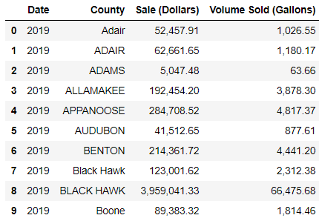
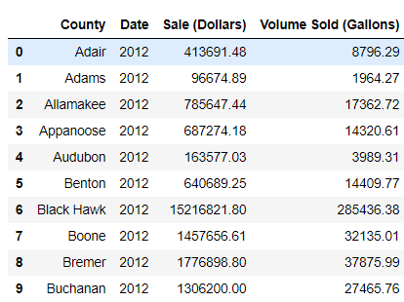
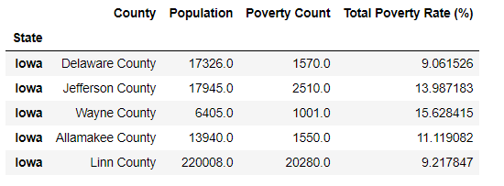
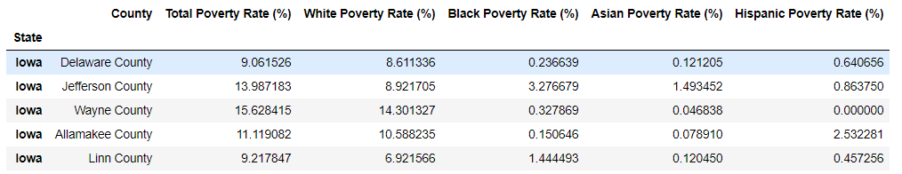
Data Cleanup
Sales Data: Reorder Columns, Removed Duplicates, Fix Letter Case, Convert to Int & Split by Years
Census Data: Reorder columns, Calculate poverty rate, Split string and Calculate racial poverty rates
Notes:
Kenny
Found individual zip codes put it in a csv file and merged it with census API data by Zip Code.
There was an issue

Slide 6
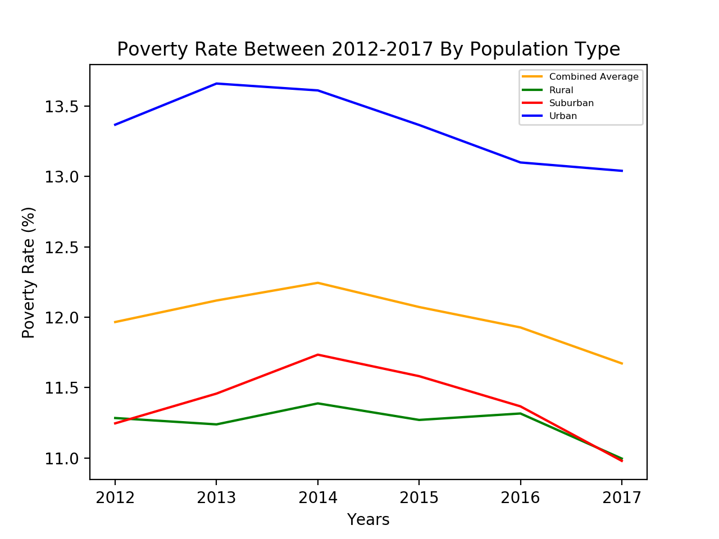
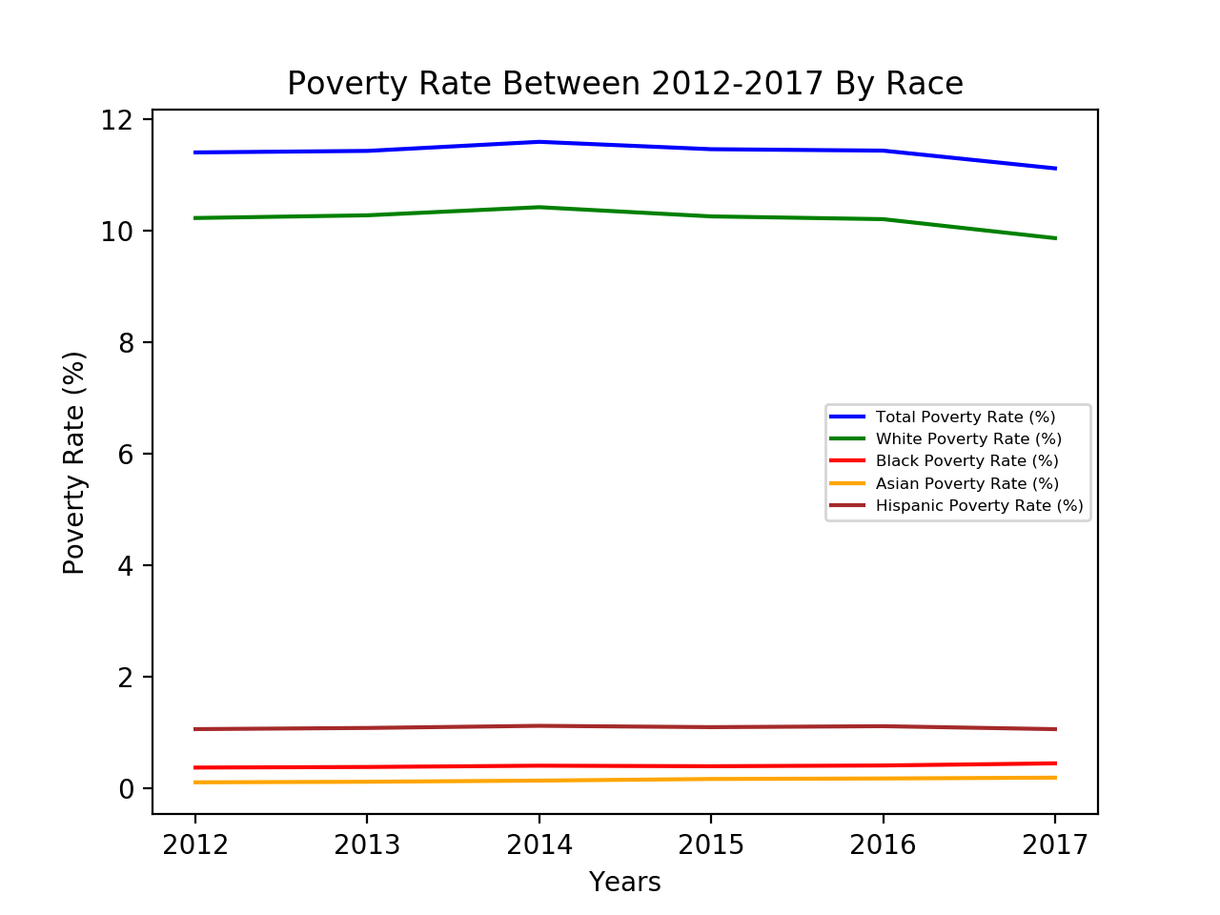
Data Analysis
Notes:
We first wanted to take a look at the poverty levels in Iowa, Initially pulled all the poverty number (number of people in poverty) for all counties in iowa from Census API then calculated the percentage in poverty rate in iowa. Averaged the mean for each year. Separated each county by population into three groups. From the groups we can see that urban areas of Iowa have the highest poverty rate whereas suburban and rural areas are much lower. Same thing with the poverty rate in different races. Poverty rate is much lower in african american, asian, hispanic. 91% of Iowa is caucasian.

Slide 7
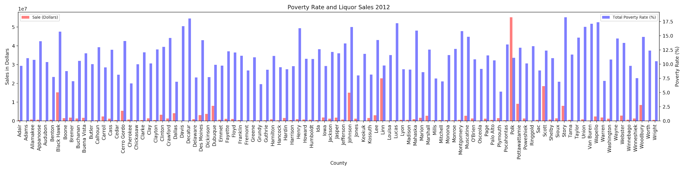
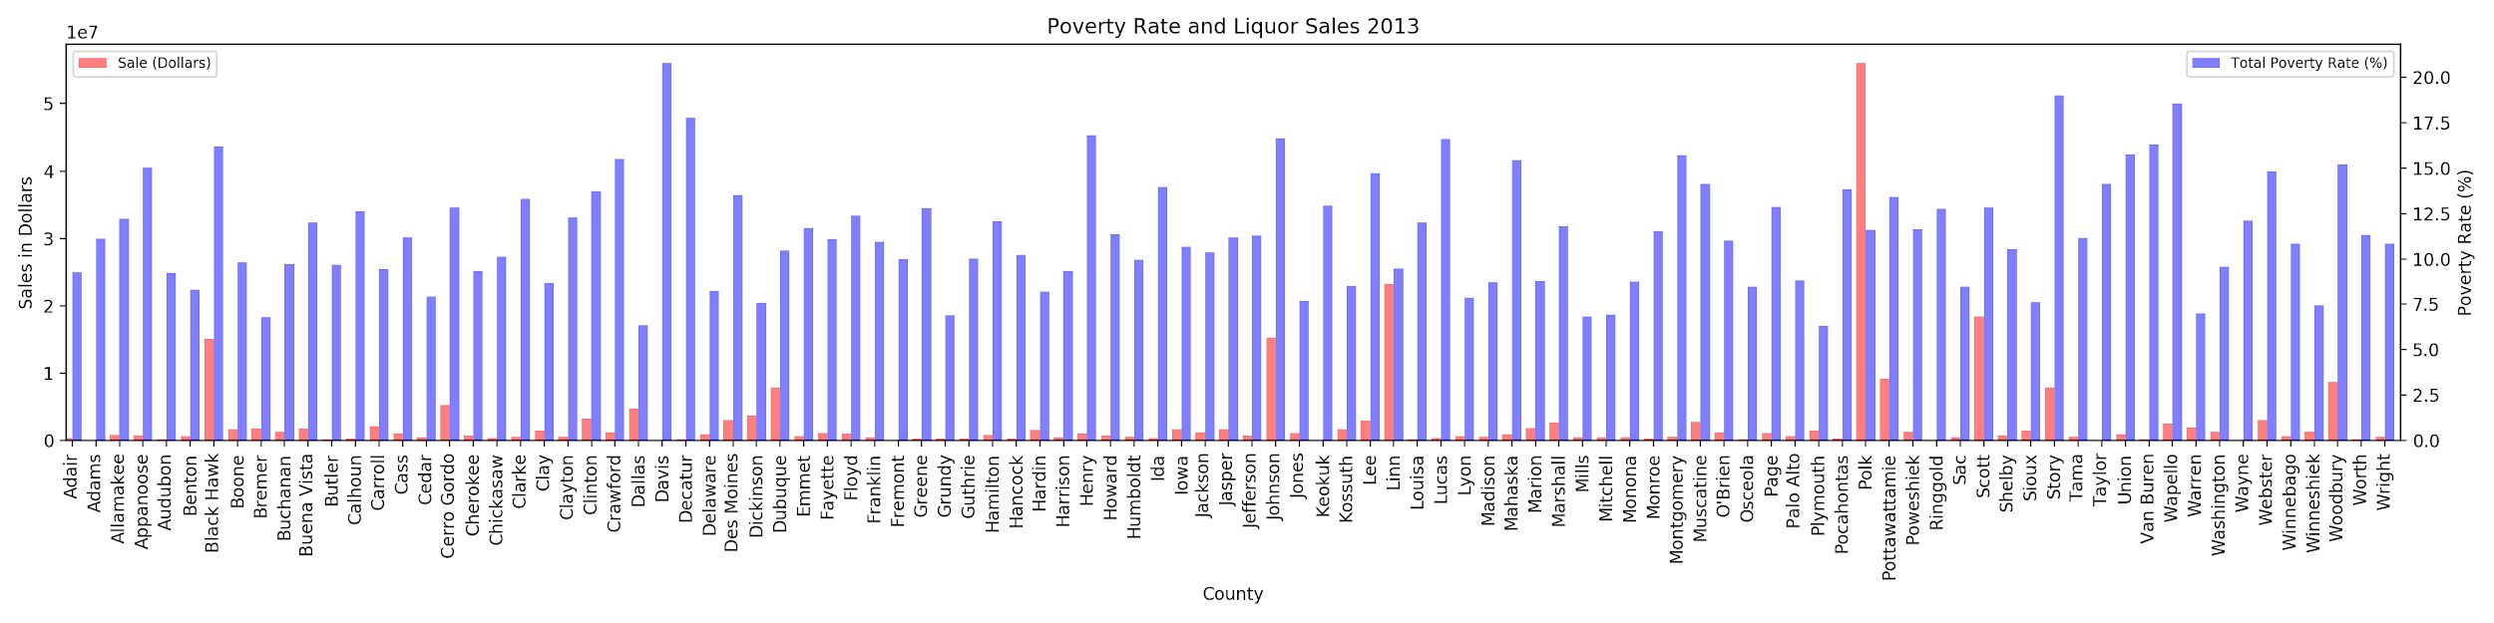
Notes:
Chart showing the liquor sales and Poverty rate by County by each year. (Created scatter with regression line but Polk county skewed the graph and did not show a very good representation of the data)
2 Y-Axis (One for Poverty Rate and one for Sales in dollars)
Sale in Dollars in 10s of Millions
Took poverty data from census api and sales data from iowa.gov website merged the two to make one table to plot the bar graphs
A LOT OF TINKERING
Findings:
Average Poverty Rate through the years for all counties:
2012: 11.97%, sales: $2,575,236
2013 12.12%, sales: $2,605,053
2014 12.25%, sales: $2,732,157
2015 12.07%, sales: $2,871,071
2016 11.93%, sales: $2,903,801
2017 11.67%, sales: $3,113,603
49.66% of all liquor sales in iowa come from 5 counties (Black Hawk, Johnson, Linn, Polk, Scott) average poverty rate of 13.09%
Top counties with highest poverty rate:
2012 (Story, Decatur, Wapello, Lucas, Van Buren) average poverty rate: 17.58, sales percent: 4.32%
2013 (Davis, Story, Wapello, Decatur, Henry) average poverty rate: 18.59, sales percent: 4.6%
2014 (Davis, Story, Wapello, Crawford, Clarke) average poverty rate: 19.13, sales percent: 4.77%
2015 (Story, Crawford, Davis, Decatur, Wapello) average poverty rate: 19.14, sales percent: 4.52%
2016 (Crawford, Story, Decatur, Davis, Wapello) average poverty rate: 19.21, sales percent: 4.43%
2017 (Shelby, Osceola, Wright, Iowa, Delaware) average poverty rate: 17.73, sales percent: 1.39%

Slide 8
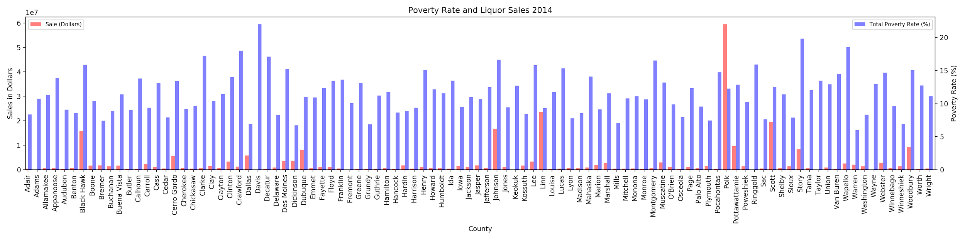
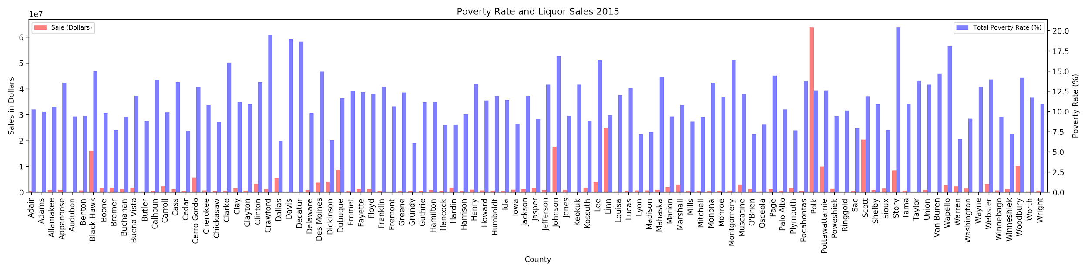

Slide 9
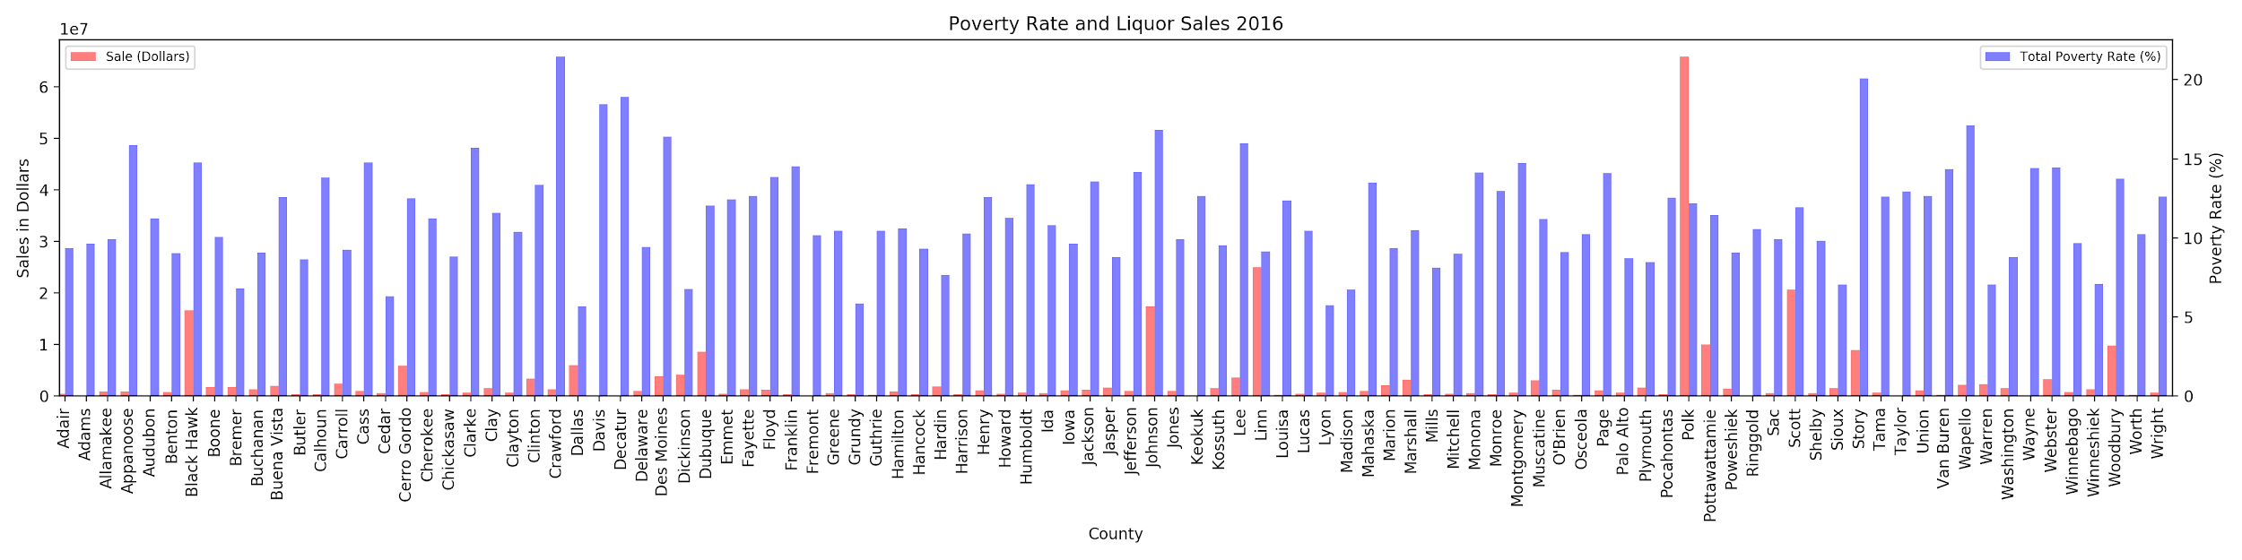
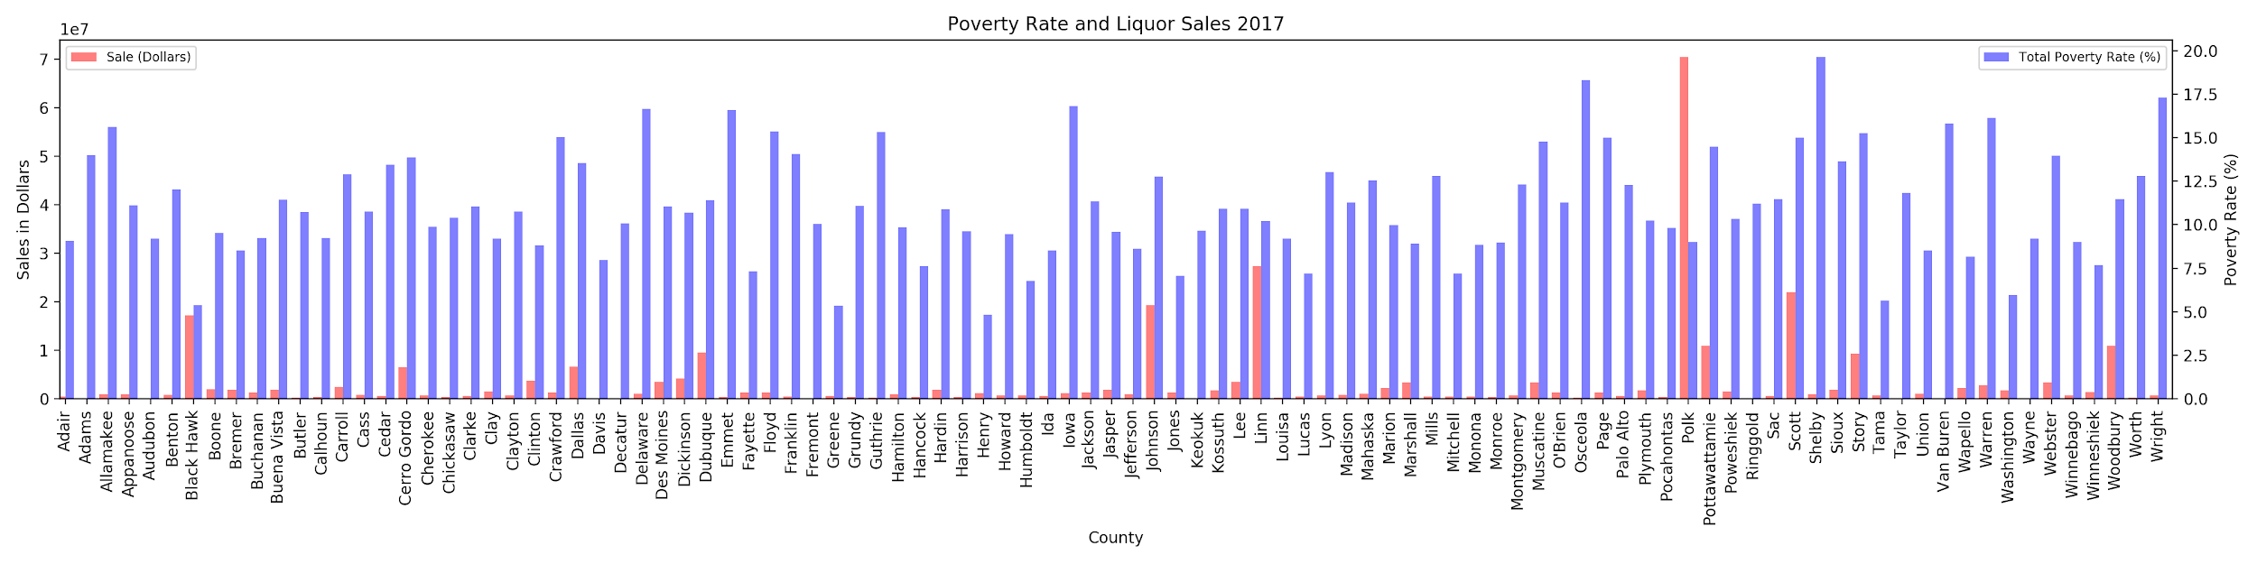

Slide 10
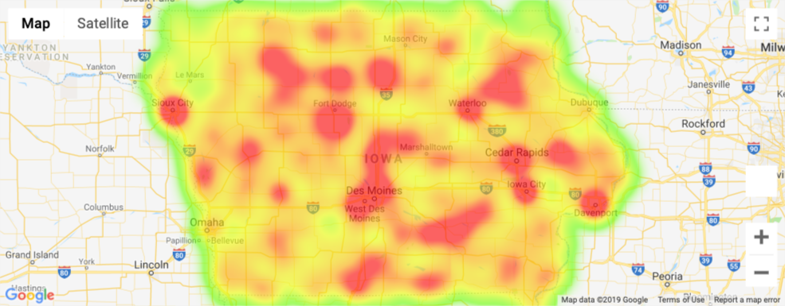
Notes:
Darker red = poverty rate (mimicked banking desert example, did the reverse of it.)
By city (zip code)

Slide 11
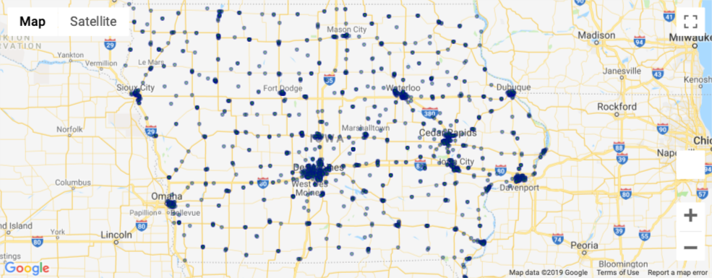
Notes:
This dataset contains the spirits purchase information of Iowa Class “E” liquor licensees by product and date of purchase from January 1, 2012 to current. The dataset can be used to analyze total spirits sales in Iowa of individual products at the store level.
This is all the off-sale
Class E liquor license, for grocery stores, liquor stores, convenience stores, etc., allows commercial establishments to sell liquor for off-premises consumption in original unopened containers.
No off-sale in this map (bar or restaurant)

Slide 12
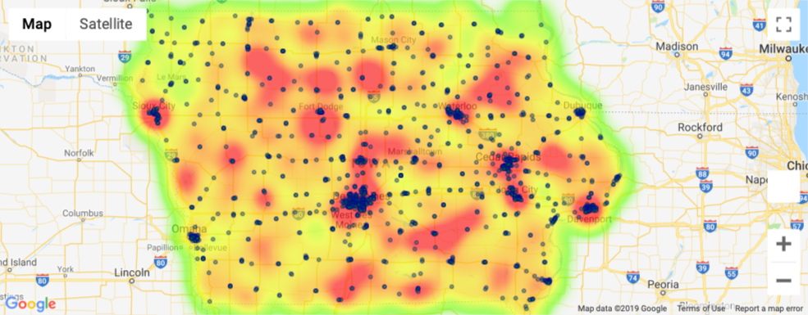
Notes:
This map shows an overlay of the poverty rate and the locations of liquor stores.
We notice that there is a larger grouping of liquor store locations in some of the higher population areas such as Des Moines, Cedar Rapids, Davenport, Waterloo, Sioux City
Urban areas on the line chart also showed that there is higher level of poverty versus the rural areas.

Slide 13
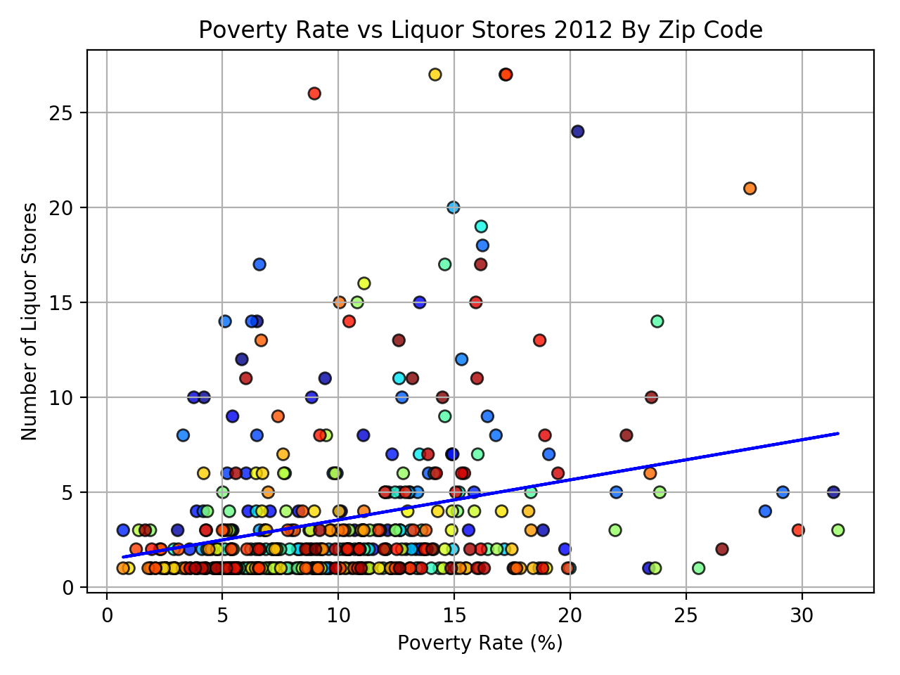
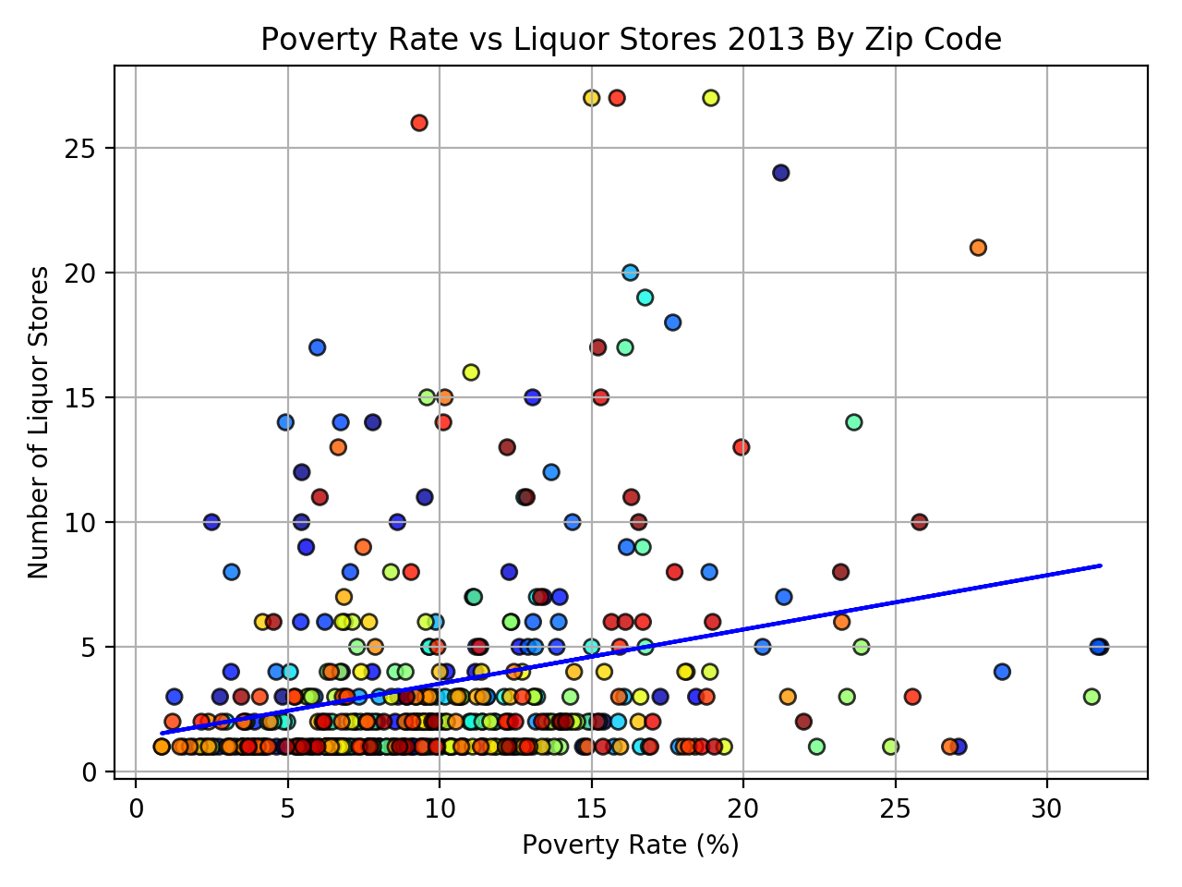
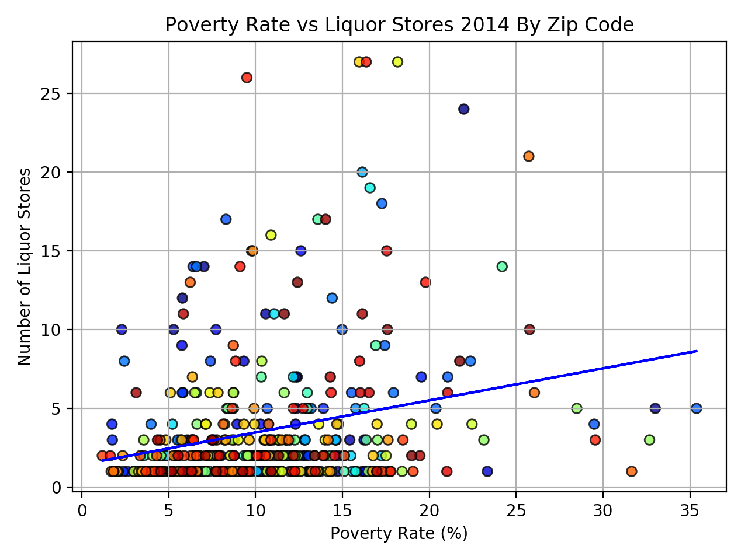
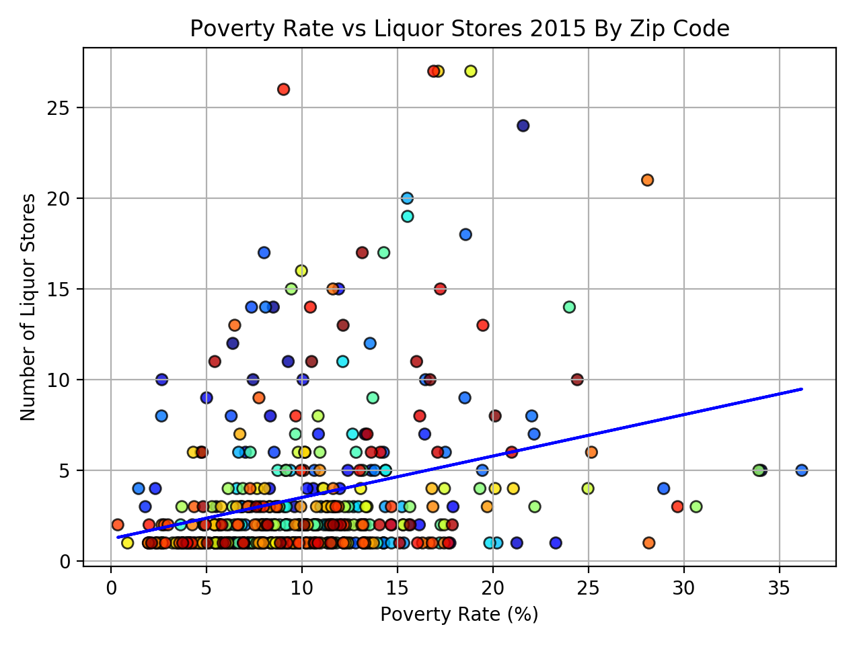
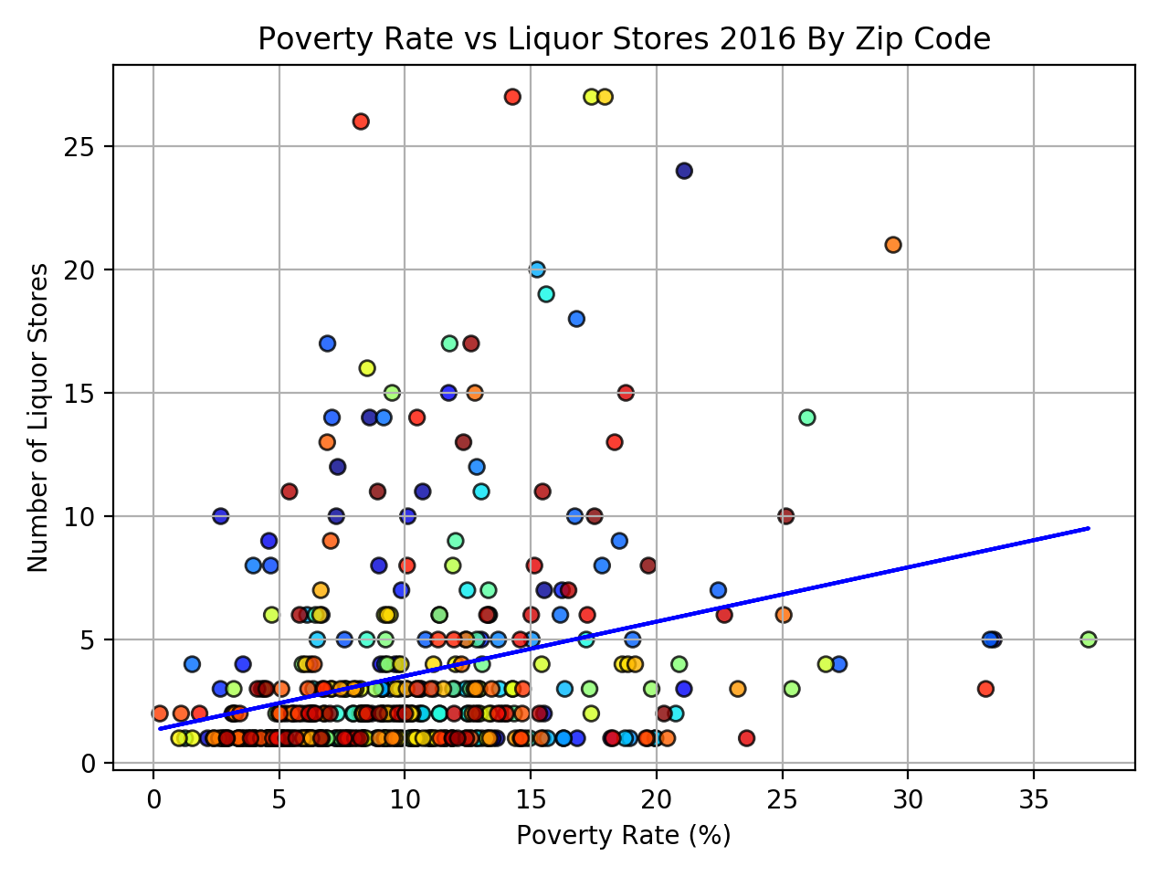
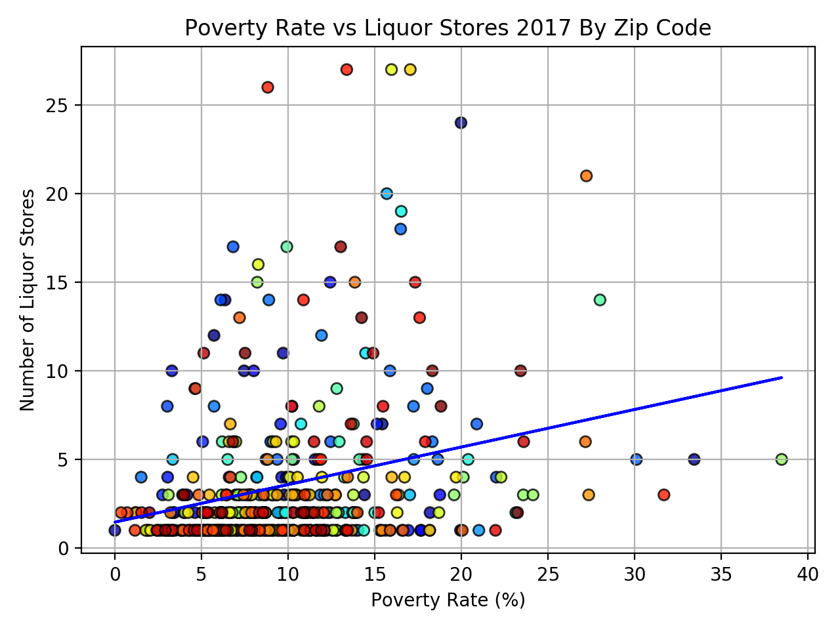
Notes:
Kenny
Graphs of poverty rate by alcohol outlet density
Couldn’t find historic store location data
Mean line of regression is .2 indicating a weak correlation between the two

Slide 14
Discussion
Discuss your findings:
Originally, we had chose the state of California but we didn’t have luck finding data on it.
We expected a strong correlation between poverty and alcohol outlet density
Mean slope of the regression line for alcohol density was 0.2153
We expected alcohol sales and poverty level to have a strong correlation
Mean slope of the regression line for alcohol sales was 0.0203
General Conclusions:
Liquor store density has some effect on poverty level, albeit a weak one.
Polk county has the highest sales, due to population and less so on poverty

Slide 15
Post Mortem
Difficulties that arose…
There isn’t a way to keep track of what race the person is when making a purchase.
We couldn’t find data to determine if the racial makeup of a county affected liquor store sales
One of our two primary data sources only had population data at the city level, while the other only provided population data at the county level
We couldn’t find year over year data on liquor stores, so we could not track their effects on poverty rate over time
Notes:
Main takeaways:
Racial data isn’t accounted for when purchasing alcohol
Iowa has very homogenous population, making it hard to find compelling racial data
finding data sources with location data that matched (i.e, city, zip, county)
Liquor store location data is from 2019 only, where as poverty rates were from 2012 - 2017

Slide 16
Questions?...
We might have answers, maybe...

